Slide 1

Bank Marketing Analysis Report
Part 2
7031ICT: Applied Data Mining
Gabriela Almeida Monteiro - s5198626
Jason Dias - s5216366
Julio Pimentel – s5172620
Notes:
Hi everyone! My name is Gabriela.
Our group has worked on a case study from a Portuguese Bank.
We have developed a classifier to predict whether a certain bank customer would subscribe or not to a term deposit.
First, we would like to start our presentation with a short storytelling about our case study. Then, we will explain how we developed our classifier.

Slide 2



Term Deposits
Notes:
2
We would like to introduce you to John Smith.
He is the manager of a very well known Portuguese Bank.
And he notices that (CLICK) the bank does not have many customers subscribing to a term deposit.

Slide 3

Term Deposits
Notes:
3
He is very worried about it.

Slide 4




What are term deposits?
Fixed-term investments
Source of income for banks
Term
Deposits
Notes:
So, what are term deposits?
Term deposits are fixed-term investments where investors deposit their money in a bank and they can withdraw the money only after the term ends.
Term deposits allow banks to use the capital for other investments and, therefore, make a profit.
In fact this is a significant source of income for banks. So, no term deposits, then profits are compromised.

Slide 5







2-year-campaign
45,111 customers contacted
5,189 customers subscribed
Marketing Campaign Results
Subscriptions
Notes:
John comes across data from a previous bank marketing campaign that wanted to convince customers to subscribe to a term deposit. He knows that (CLICK) the campaign lasted around 2 years and in the end they contacted 45,111 customers, but only 5,189 subscribed. This (CLICK) equates to approximately 1 in every 10 customers.

Slide 6

Wouldn’t it be more efficient if we could identify and target only customers that are likely to subscribe to a term deposit?
Notes:
6
John was wondering: Wouldn’t it be more efficient if we could identify and target only customers that are likely to subscribe to a term deposit?

Slide 7


Notes:
Luckily, he can count on GJJ Machine Learning Consultants.

Slide 8

93%
Notes:
GJJ has developed a machine learning algorithm that has (CLICK) 93% of accuracy.
So, how does it work?

Slide 9
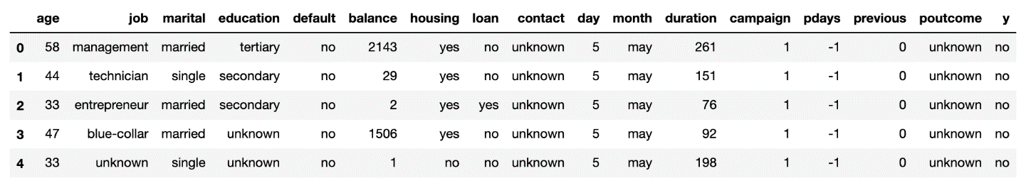


How does it work?
Potential
Term Deposit Customers
Notes:
First, the bank has customer data that holds several features such as: age, job, marital status, education, and many others features. Then, with these features, it is possible to train various machine learning models to predict (CLICK) which customers are more likely to subscribe to a term deposit.

Slide 10

Notes:
And then, staff will call only to customers that are likely to subscribe.
This will help banks’ marketing campaigns to be much more efficient.
They will be shorter and will require less staff.

Slide 11


Profit
Notes:
11
As a result, revenues of Term Deposit will increase and bring more profit to the banks.

Slide 12

The magic behind...
The Magic behind…
Notes:
Now Jason and Julio will show you the magic behind our classifier.

Slide 13

About the Dataset
The dataset covers campaign data from May 2008 to November 2010 (Moro, Cortez, & Rita, 2014)
It contains 39,922 “no” and 5,289 “yes”
The Data comprises of
45,211 records
17 columns
7 numerical variables
10 categorical variables

Slide 14
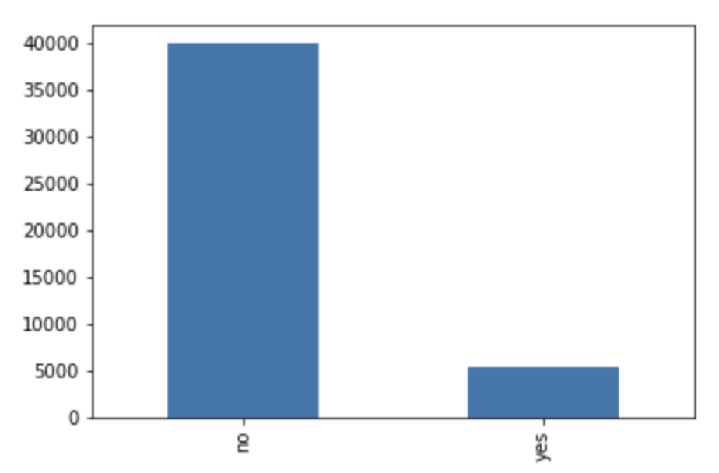
Data Imbalance
The imbalance in data may cause bias when training our models, and therefore, special attention was given in making sure that the data is balanced when fitting our model to the data

Slide 15
Data pre-processing
1) NULL VALUES
Columns with a large number of “unknown” values will be dropped. This is the case of the “contact” and “poutcome” columns.
Unknown values in the age attribute will be replaced by the average age of the customers.
Rows with unknown values in education will be dropped.
2) BINNING
Categorising age attribute using equal-width binning

Slide 16
Data pre-processing
3) Z-SCORE NORMALISATION
normalise the variation of units of data present in the data set
applied to all categorical variables such as job, marital, education, default, housing and loan
4) ONE-HOT ENCODING

Slide 17
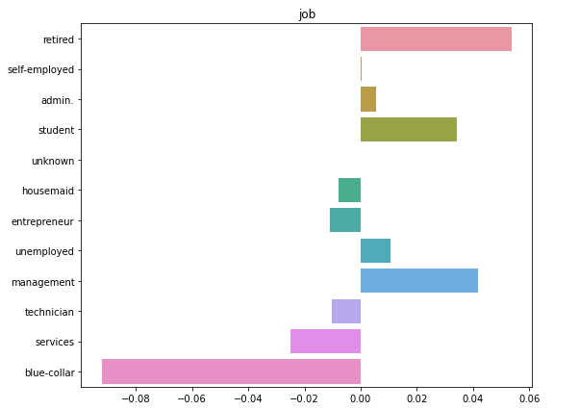
Data insights

Slide 18
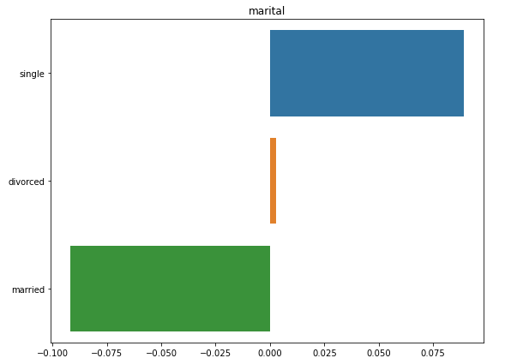
Data insights

Slide 19
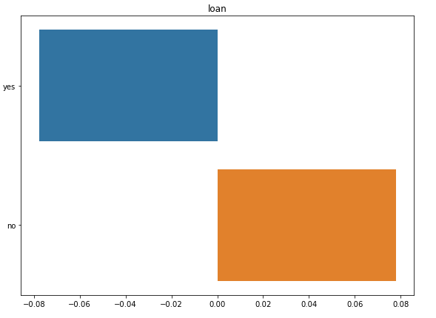
Data insights

Slide 20
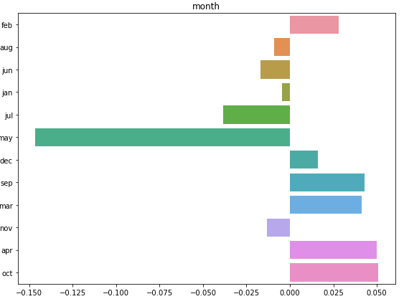
Data insights

Slide 21
Data insights
For the bank to see their term deposit to have a positive impact and have a profitable turnover, the marketing team should focus on students and retired age group who are possible single and having no loan to their name.
In addition, a promotional campaign could be rolled out in February, March, April, September and October to know how the new term deposit scheme performs.

Slide 22
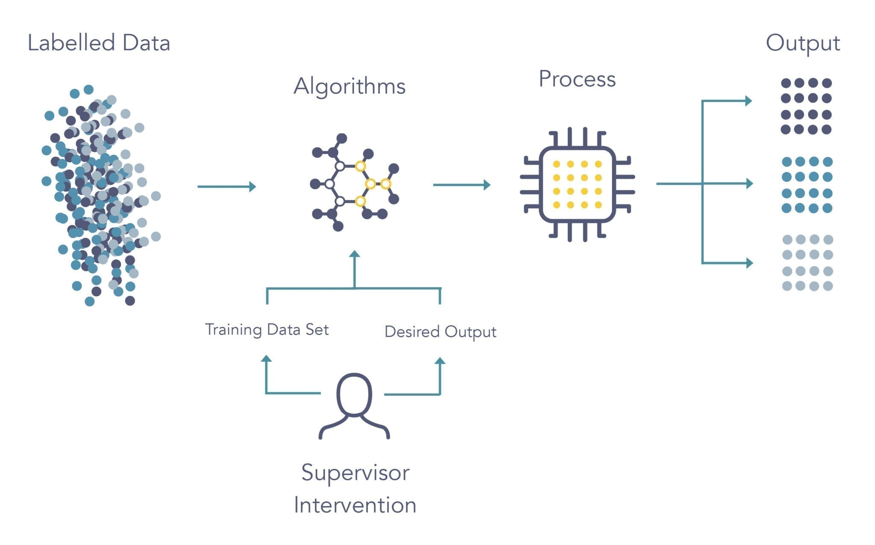
Supervised learning
Notes:
https://7qkiy1yofpnz20qc4wdcb9t6-wpengine.netdna-ssl.com/wp-content/uploads/2020/07/machine-learning-infographics-2-scaled.jpg

Slide 23
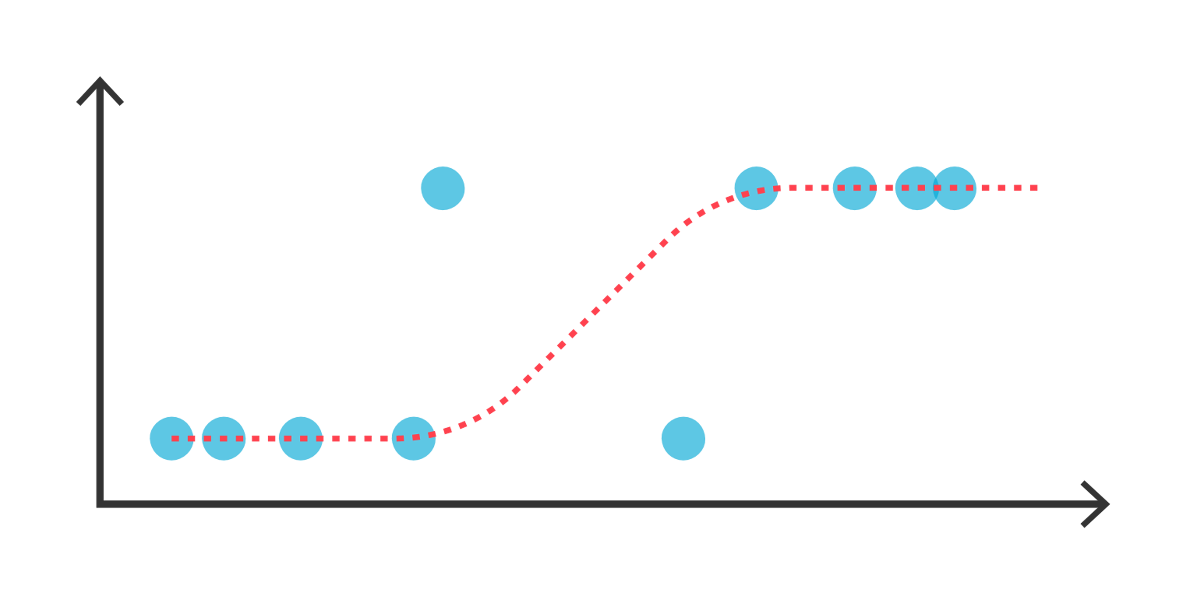

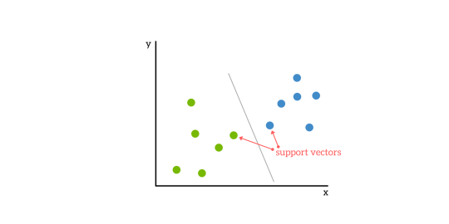
Random Forest
Logistic Regression
Support Vector Machine
Notes:
https://www.google.com/url?sa=i&url=https%3A%2F%2Fwww.tibco.com%2Freference-center%2Fwhat-is-a-random-forest&psig=AOvVaw3DdEsRoWSv24bLruMD_f0c&ust=1633693866967000&source=images&cd=vfe&ved=0CAkQjRxqFwoTCMCi4qieuPMCFQAAAAAdAAAAABAD
https://www.google.com/url?sa=i&url=https%3A%2F%2Fwww.tibco.com%2Freference-center%2Fwhat-is-logistic-regression&psig=AOvVaw0OpOx77adkIgYsp_2Ry4Ox&ust=1633693907590000&source=images&cd=vfe&ved=0CAkQjRxqFwoTCOilxp2euPMCFQAAAAAdAAAAABAD
https://www.google.com/url?sa=i&url=https%3A%2F%2Fwww.kdnuggets.com%2F2016%2F07%2Fsupport-vector-machines-simple-explanation.html&psig=AOvVaw2abGVX0tAVpBxnrT1RfUmm&ust=1633693958326000&source=images&cd=vfe&ved=0CAkQjRxqFwoTCPjT1reeuPMCFQAAAAAdAAAAABAD

Slide 24
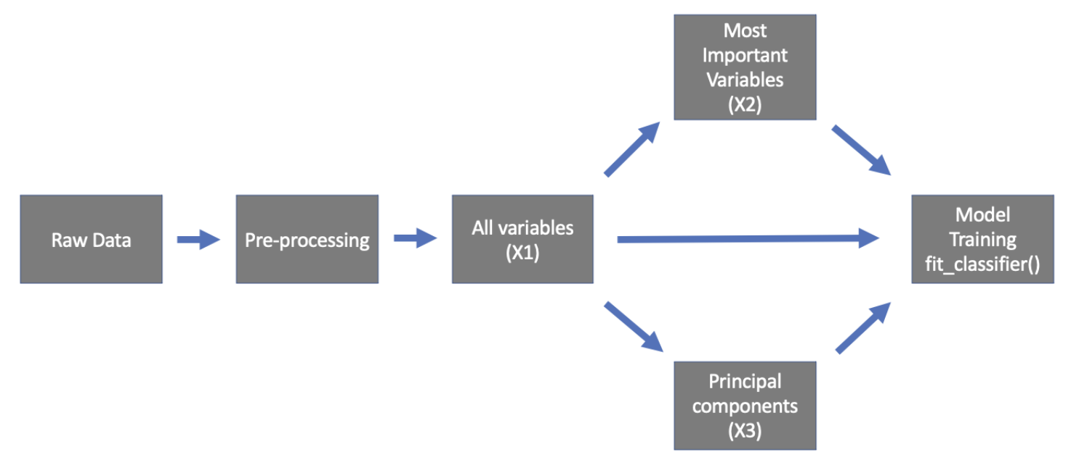
Steps to develop the models

Slide 25
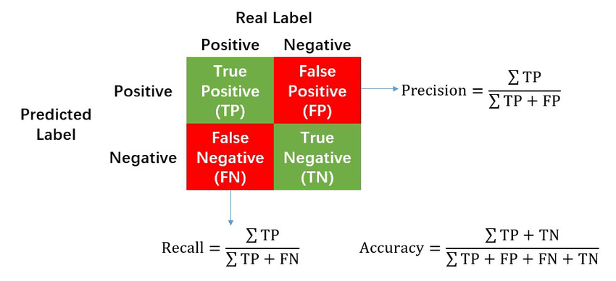
What is recall?
Proportion of positives cases that are identified as positive
Notes:
https://www.google.com/url?sa=i&url=https%3A%2F%2Fwww.researchgate.net%2Ffigure%2FCalculation-of-Precision-Recall-and-Accuracy-in-the-confusion-matrix_fig3_336402347&psig=AOvVaw26jJmrunH4bi6RkB5qfh82&ust=1633694263437000&source=images&cd=vfe&ved=0CAkQjRxqFwoTCLil8cWfuPMCFQAAAAAdAAAAABAD

Slide 26
Results of the model
Notes:
Why the big difference?
The undersampling method on R were different and it utilised cross-validation

Slide 27
Thank you!
Notes:
Why the big difference?
The undersampling method on R were different and it utilised cross-validation

